Slide 1
IOI: In-network Optical Inference
Workshop on Optical Systems (OptSys’2021)
Zhizhen Zhong, Weiyang Wang, Manya Ghobadi,
Alexander Sludds, Ryan Hamerly, Liane Bernstein, Dirk Englund
August 23, 2021
Notes:
Hello everyone. I am Zhizhen Zhong, a postdoc researcher at MIT CSAIL with Prof. Manya Ghobadi.
Today I will present our explorations on enabling in-network optical inference with IOI.

Slide 2
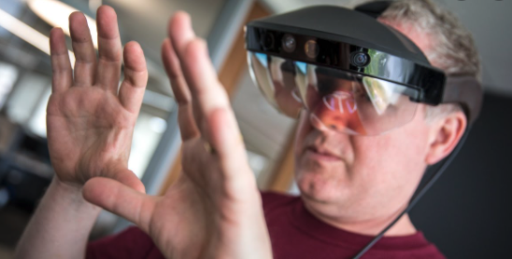
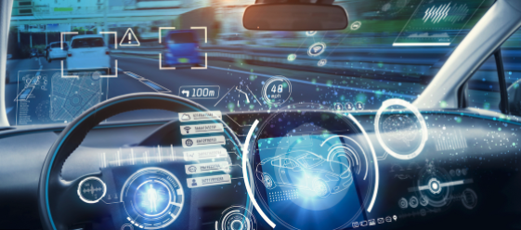
The need for low-latency ML inference
ML inference is latency sensitive
VR/AR requires 1 ms otherwise users feel dizzy.
Autonomous cars require ~10 ms to be safe.
Notes:
In recent years, we have experienced a significant increase on machine learning applications. For example, we use these machine learning models to for improving the user experience in virtual reality, augmented reality and decision making in autonomous vehicles.
Here, inference means we already have a trained machine learning model, and we want to run data through the model and read its output to make decisions. For machine learning inference tasks, they are usually latency sensitive. For example, virtual reality glasses require less than 1 milliseconds response time otherwise the users will feel dizzy. Autonomous cars requires less than 10 milliseconds response time for reactions to be safe on the road.

Slide 3
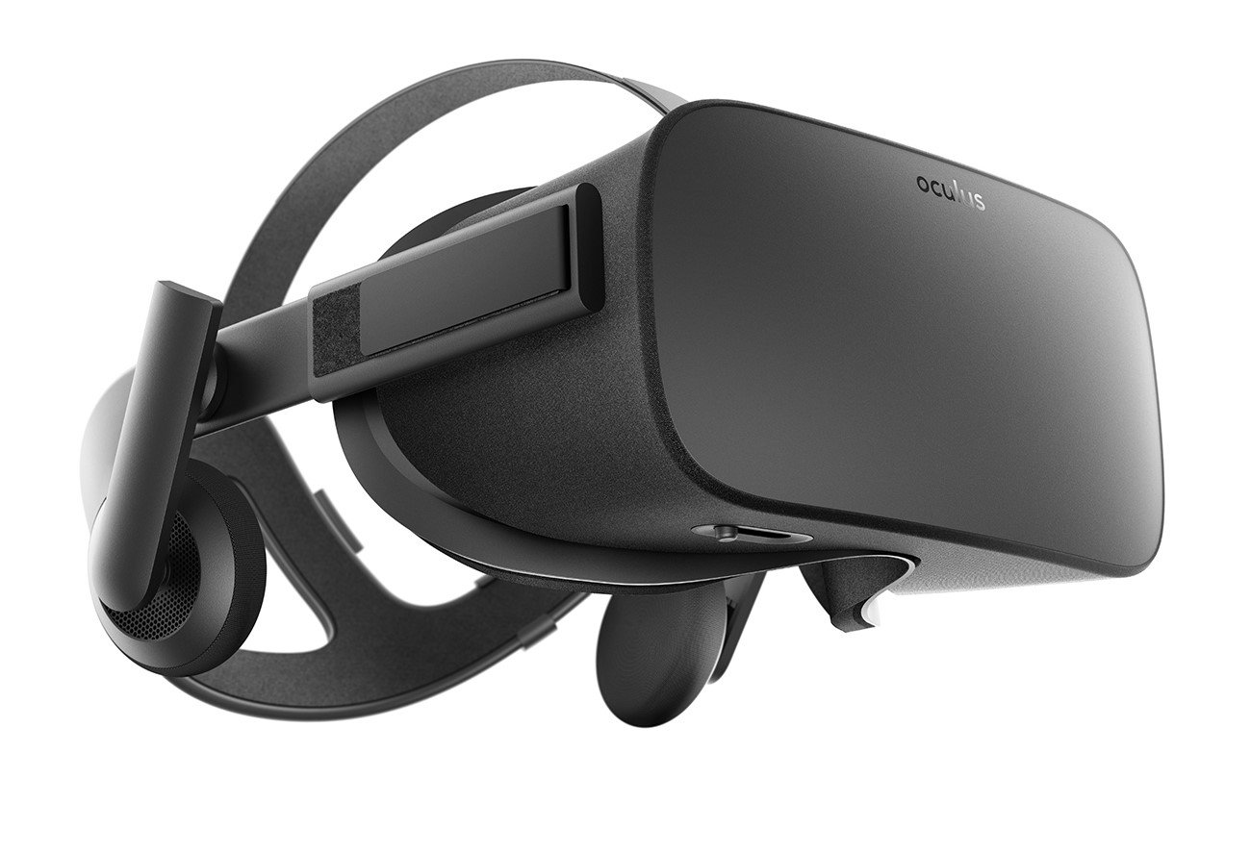
Where should inference happen?
For ideal latency: inference should be done on device
Challenge: IoT devices have limited battery/compute capabilities
State-of-the-art: inference on edge/cloud
Notes:
To keep latency low, where should inference happen?
For ideal latency, inference should be done on devices. However, the challenge of on-device machine learning is that those Internet-of-things devices, like smart watches, virtual reality glasses, smart phones, have limited battery and computation capabilities. Hence, these devices cannot host large-scale machine learning models.
The state-of-the-art approach is to host the large-scale machine learning models on on edge or cloud servers and run inference in a remote session.

Slide 4
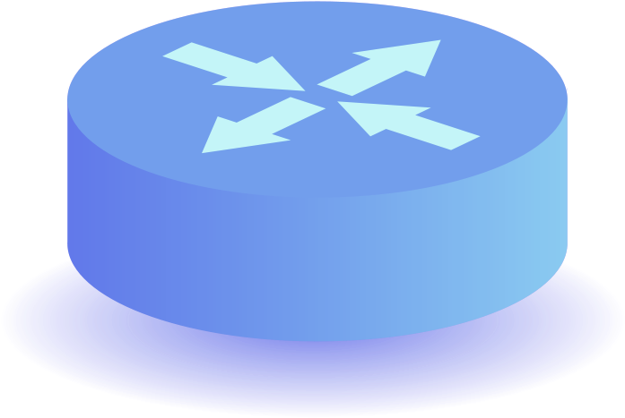
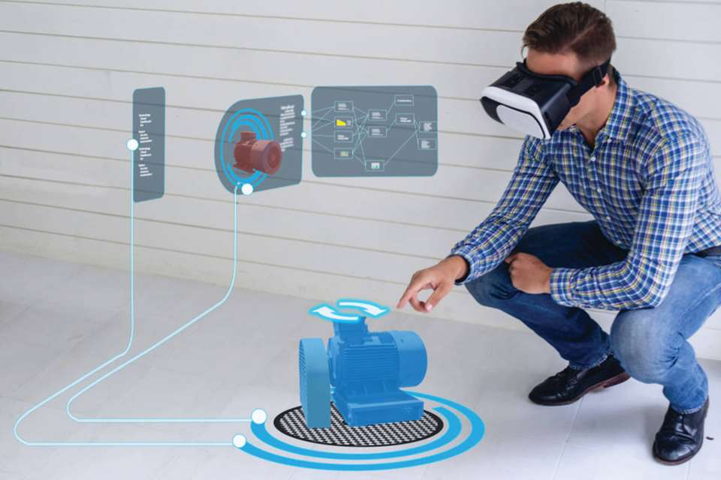
What is the problem with inference on edge/cloud?
Tens of milliseconds packet processing latency
PCIe Bus
100Gb/s
Network Interface Card
CPU
Memory
GPU
2-3GHz
Inference servers
CPU on inference servers is responsible for tens of ms latency!
Inference servers are far away, signal propagation 200km/ms.
Notes:
Let us look deeper into today’s inference on edge/cloud servers and figure out what is the problem with this paradigm.
In this setting, the user is using a virtual reality glass and need to run inference in real time.
[click] As we discussed before, today the machine learning model is stored in the edge/cloud inference servers.
[click] Therefore, the user data has to go all the way along the Internet the edge/cloud data center. Inside the internet, the data needs to be routed through multiple switches to reach the destination server.
[click] If we open up the server box, the data flow enters the server through the network interface card, the being processed by the CPU for decoding data from TCP/IP packets. Then the decoded data is flushed into memory and finally arrives at GPU for inference calculations.
[click] In this entire process, the CPU packet processing step adds tens of milliseconds packet processing latency, especially for high-speed data flows because of the clock frequency of CPU is only 2-3 GHz.
[click] Meanwhile, because these edge/cloud inference servers are far away, so all the data has to go throughput a long physical distance. Considering the fact that the signal propagation speed in fibers is 200km/ms. If the user need to send the data to data center that is thousands of kilometers away, then the round trip time on the fiber path would tens of milliseconds.

Slide 5
Our proposal: Inference on the switch
Computation as data moves!
Transceiver
Programmable packet processing ASIC
A few microseconds packet processing latency
Inference module
Notes:
[click] Our proposal is to move the machine learning inference to network switches, and runs computation as data moves!
[click] In this way, the data path for inference data flows will stop at switches and no longer need to visit servers.
[click] On switches, we have transceivers that can send and receive optical data on fibers and conver them into electrical binary data. We also have a programmable packet processing ASIC that can run simple programs on data packets at line rate with only a few microseconds of packet processing latency without delaying the packets.
[click] Because machine learning inference tasks involves complex matrix multiplication calculations that are beyond the computing capabilities of packet processing ASIC, we will need to add a inference module to switches to achieve on-switch inference.

Slide 6
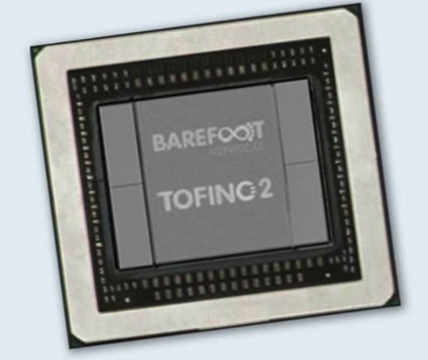
Packet Processing: Switch ASIC vs. CPU
CPU chip
Xeon Gold 6152 2.1GHz ⇒ 5.2 million packet per second (PPS).
Switch ASIC chip
Tofino II 32 ports 400GbE ⇒ 6 billion packet per second (PPS).
In-network computing is 1000x faster than server-based computing.
https://www.intel.com/content/dam/www/public/us/en/documents/case-studies/att-cpu-impact-on-packet-processing-perfomance-paper.pdf
Notes:
As we discussed, one major difference between our proposal on in-network computing versus server-based computing is that we leverage the programmable switch ASIC to run packet processing instead of CPUs.
[click] If we compare the performance of these two chips, a state-of-the-art CPU chip has a packet processing speed of 5.2 million packets per second, meanwhile, the state-of-the-art programmable packet processing ASIC, Tofino, can achieve 1000x faster packet processing. This will significantly reduce the packet processing delay that are experienced on server end.

Slide 7
Why isn’t in-network inference deployed today?
Switch ASIC is designed with a pipeline structure to process data at line rate (100Gb/s)
Limited memory (~MB)
Limited computation capabilities (integer).
Cannot handle matrix multiplication operations.
Transceiver
Packet processing ASIC
Inference module
Notes:
With this promising gain, why isn’t in-network inference deployed today?
[click] Well, the reason is, the programmable switch ASIC is designed with a pipeline structure to process data at line rate, so it is not designed for carrying out complex computation tasks, like matrix multiplication.
[click] This switch ASIC has very limited memory, several megabytes, and can only simple process integer computations.
[click] All these limitations makes today’s network switches not ready for running machine learning inference tasks.

Slide 8
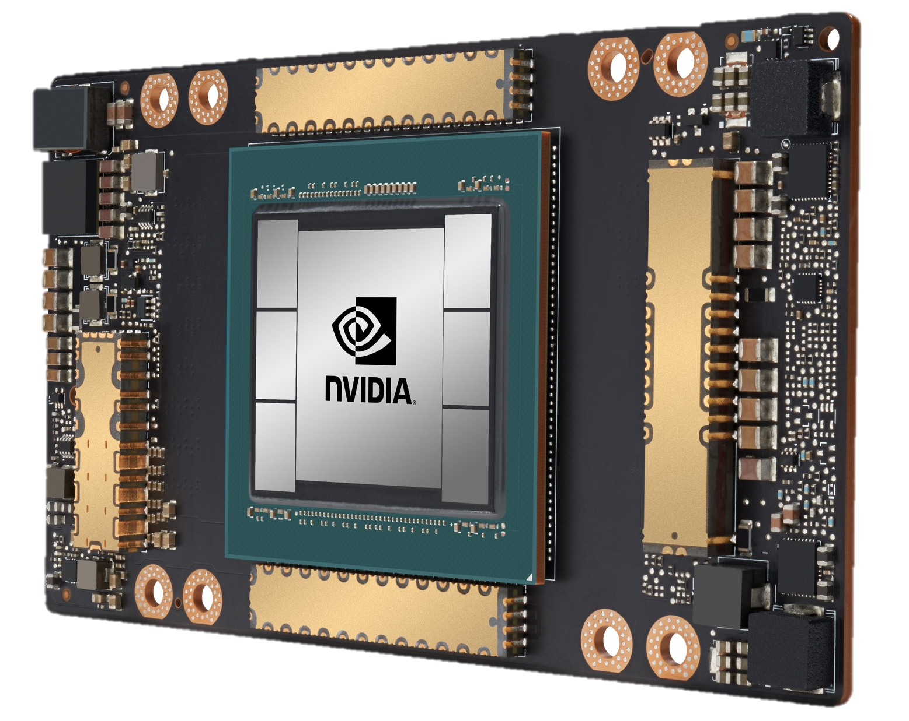
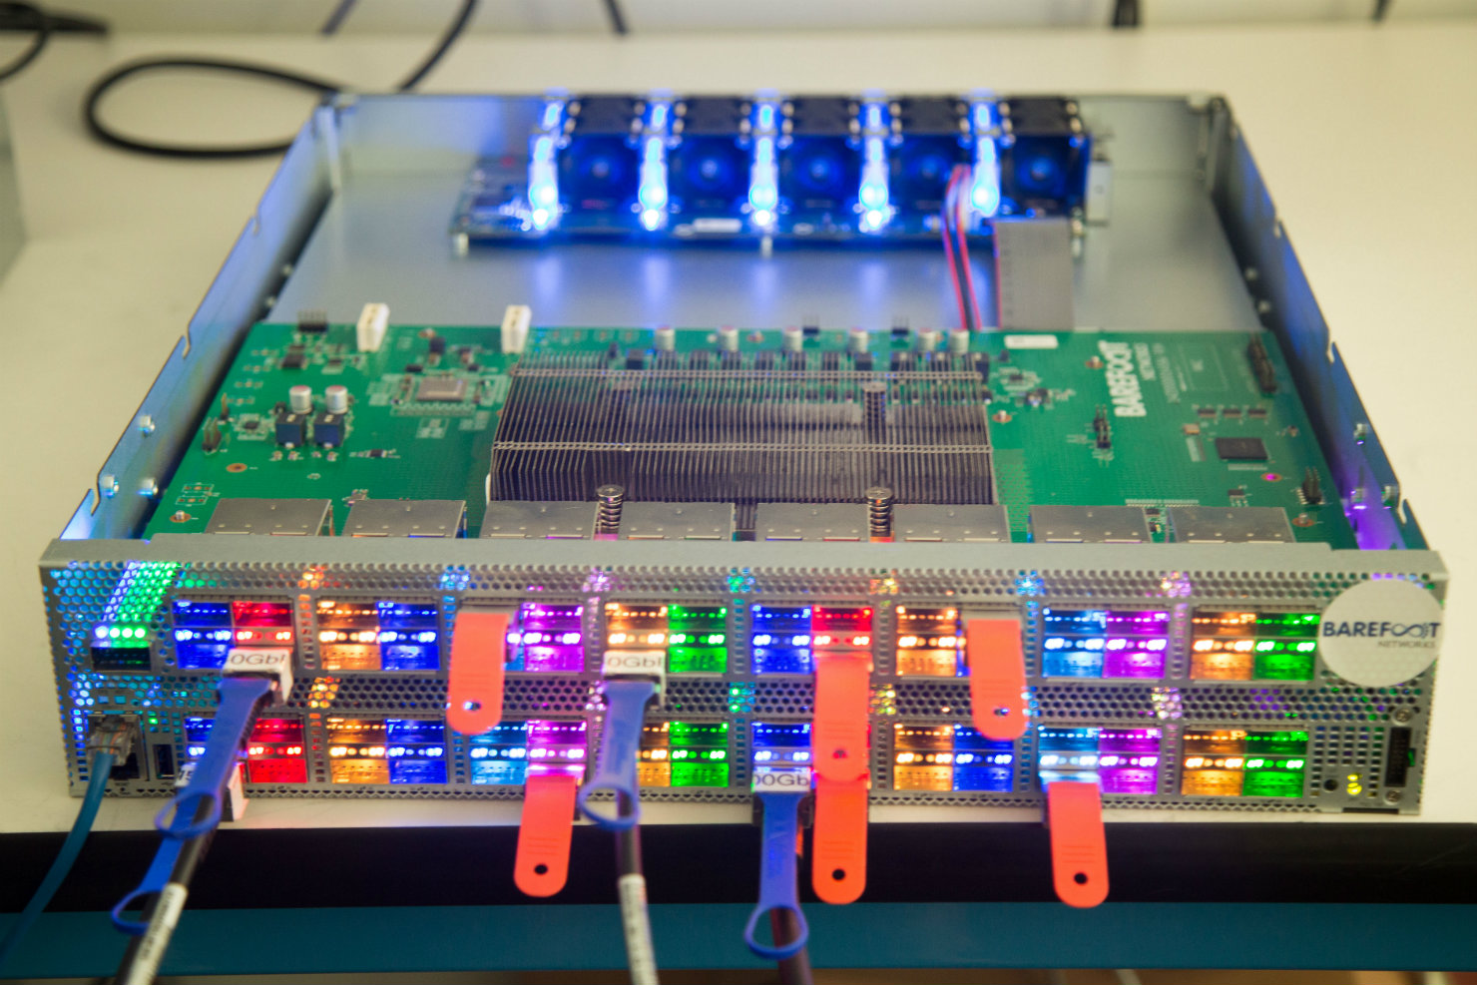
Strawman design: add GPUs to switches
Nvidia A100 GPU
Computation: 765 MHz clock frequency
Cost estimate: 12k USD
GPUs
Ethernet switches
Notes:
A strawman design is, can we add a GPU to a switch to augment the switch with machine learning inference capabilities?
[click] Well, we can do this, but this will complex the design of the switches, because we now need to make the entire GPU card to fit into the switches. Another perspective is, considering the huge number of switches deployed in today’s Internet, this approach will requires us to add GPUs to so many switches. Considering the state-of-the-art Nvidia A100 GPU, it has a 765 MHz clock frequency, and the unit cost is 12k USD. Addin GPU cards to switches would be a very costly option.

Slide 9
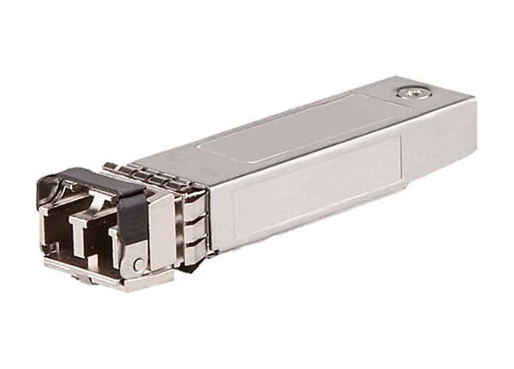
Can we use something already on switches?
MOD (modulator): – multiply electrical data onto optical waves intensity
PD (photodetector): decode optical wave intensity to electrical data
Ethernet switches
Electrical
data
Transceivers
Optical data $x$
Laser
Electrical data $x$
MOD
Optical wavelengths
PD
Optical data $x$
Electrical data $x$
Notes:
Can we use something that is already on switches to achieve the same goal and avoid adding GPU cards? Yes we can.
[click] In today’s network switches, every router ports are coupled with a device called optical transceiver.
[click] The job of the transceiver is to convert signal between optical wavelengths and electrical data.
[click] If we open up an transceiver module, there are two major devices inside, modulator (in short form MOD) that works to multiply electrical data onto optical wave intensity, and photodetector (in short form PD) that decode optical wave intensity to electrical data.
In the entire Internet, there are millions of transceivers deployed in network switches, the unit cost for a regular transceiver module is usually around 100 USD or less.

Slide 10
Repurpose transceivers for optical computing
Add one extra MOD (modulator) to achieve optical matrix multiplication.
The time-domain integration $\sum_{time}{x×y}$ is achieved by increasing the PD detection time window.
Ethernet switches
Electrical
data
Transceivers
Optical data $x$
Laser
Electrical data $y$
Electrical data $x$
MOD
MOD
Ryan Hamerly, Liane Bernstein, Alexander Sludds, Marin Soljačić, and Dirk Englund. "Large-scale optical neural networks based on photoelectric multiplication." Physical Review X 9, no. 2 (2019): 021032.
Optical wavelengths
PD
Electrical data $\sum_{time}{x×y}$
Optical data $x$
Electrical data $x$
Optical data $x×y$
Notes:
In our design, we propose to repurpose transceivers for running computing in the optical domain.
[click] On the regular transceivers, we add one extra modulator between the existing modulator and photodetector to achieve the goal of matrix multiplication entirely in the optical domain.
[click] Basically, in matrix multiplication, there are two operations, multiply and accumulation.
[click] Specifically, the first modulator will multiply electrical data x onto optical wave intensity, hence currently the optical wave is carrying data x in the optical domain. Then, the second modulator will modulate data y on the top of this optical wave which will return an optical wave with intensity of x multiplied by y. Then we use a photodetector to decode the x multipled by y into electrical domain. The accumulation operation is achieved by increasing the PD detection time window so that the PD will return multiple x multiplied by y in time domain. The fundamental theory of physics of this optical matrix multiplication process is discussed in detail in this PRX paper published in 2019.

Slide 11
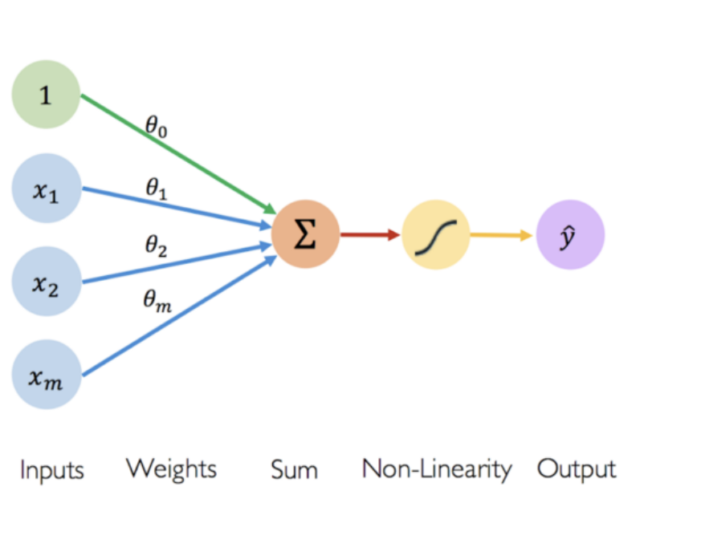
Our proposal: use Optical Neural Networks (ONNs)
$$W_{[m×n]}$$
$$X_{[n×1]}$$
$$Y_{[m×1]}$$
Laser source
@100 channels
Photodetector (PD) array
Modulator array @10GHz
$$X_{[n×1]}$$
$$W_{[m×n]}$$
$$Y_{[m×1]}$$
Optical modulator/photodetector array
Computation: 10 GHz frequency
Cost estimate: Laser (3k USD) + 50 MOD & PD (1.25k USD) = 4.25k USD
Optical computing is 13x faster & 3x lower cost than GPU-based computing.
Notes:
Therefore, instead of adding a GPU card to switches, our proposal is to leverage optical neural networks that can be integrated into today’s transceivers.
[click] For a neural network layer, the input of this layer is a n-size vector X, and the weights of the neural network is a m by n matrix, the vector-matrix product is carried out by our proposed optical computing paradigm that only invoves commercially available devices of modulators and photodetectors in transceivers.
[click] If we compare our proposal with the GPU, the computation speed of optical computing is at 10 GHz frequency while GPU operates at 700 MHz. On the other hand, our optical design only requires off-the-shelf devices to to build an equivalent optical neural network of the A100 GPU the cost estimate would only be 4.25k USD
[click] Therefore, our proposal is going to be 13 times faster, and 3 times lower cost than GPU-based solutions.

Slide 12
Bringing the best of both worlds
 | In-network inference | Optical computing
Advantages | Latency, nonlinearity | Matrix multiplication
Limits | Matrix multiplication | Nonlinearity
Combining in-network inference with optical computing –
In-network optical inference (IOI)
IOI has fundamentally advantages over any server-based (electrical or optical) inference in latency.
Notes:
However, while the optical computing has huge advantages in speed and cost for matrix multiplication computations than electrical solutions. It also has a challenge that optical computing cannot handle nonlinearity properly. For decades, this is a long-standing challenge in the optical community.
Instead, nonlinearity computation can be done in the electrical domain quite easily because it does not involve complex matrix operations.
[click] Therefore, we combine in-network inference with optical computing, and propose in-network optical inference, or IOI to bring the best of both electrical and optical worlds.
[click] IOI has fundamental latency advantages over any server-based, no matter electrical or optical machine learning inference because of the in-network computing design.

Slide 13
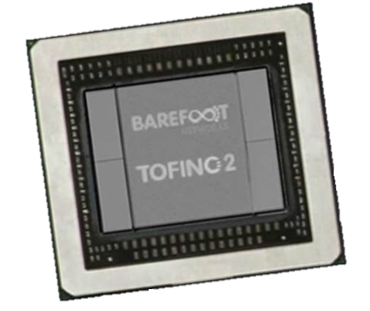
In-network Optical Inference (IOI) system design
Internet
IOI transceiver
Client
Laser
$W_{[m×n]}$: neural network weights
Fiber
MOD
ReLU on switch
Match: y >= 0
Action: no action
Match: y < 0
Action: y = 0
MOD
PD
$Y_{[m×1]}=W_{[m×n]}×X_{[n×1]}$: MAC result
$X_{[n×1]}$: User data to infer
Multiplication
Accumulation
Nonlinearity
IOI switch
Notes:
So, we present the in-network optical inference system.
[click] The IOI system contains IOI switches that has programmable packet switching ASICs and our specially designed IOI transceivers.
[click] When the client send a inference request to the IOI switch, its matrix multiplication is done on the IOI transceiver, and its nonlineary activation (ReLU) is done inside the programmable switch ASIC by simply matching the positive/negative sign digit of the numbers and take corresponding actions following the match-action design of the pipeline architecture.

Slide 14
Challenges
Challenge 2:
Limited memory on programmable switches.
Solution: designing the packet structure such that each packet can fit into today’s programmable switch ASIC.
Internet
IOI transceiver
IOI transceiver
Client
Laser
$W_{[m×n]}$: neural network weights
Challenge 1:
Synchronization between inputs ($x$ & $y$) at two modulators.
Solution: encoding $x$ & $y$ into the same data packets using programmable switch.
Fiber
MOD
ReLU on switch
Match: y >= 0
Action: no action
Match: y < 0
Action: y = 0
MOD
PD
$Y_{[m×1]}=W_{[m×n]}×X_{[n×1]}$: MAC result
$X_{[n×1]}$: User data to infer
Multiplication
Accumulation
Nonlinearity
IOI switch
IOI switch
Notes:
However, this innovative and promising design also comes with challenges.
[click] On the transceiver side, because we involve two modulators to carry out the multiplication operation of x and y, hence the synchronization between the inputs, x and y at two modulators are challenging. We solve this challenge by encoding the x and y into the same data packets using a specially-designed programmable switch match-action logic.
[click] On the IOI switch side, we also have challenges due to the limited memory on programmable switch ASICs. We solve this challenge by carefully designing the packet structure and distributing the entire inference data flow into multiple packets so that each packet can fit into the memory constraint of today’s programmable switch ASIC.

Slide 15
Concluding remarks
Optical computing is the next frontier to enable fast matrix multiplication.
Our proposed system (IOI) augments programmable switches with optical compute units as “IOI transceivers” to enable in-network inference.
IOI opens up new exciting opportunities for machine learning systems for line-rate processing and ultra low latency.
Notes:
In conclusion,
[click] Optical computing is the next frontier to enable fast matrix multiplication, due to its significant speed, energy and cost advantages.
[click] Our proposed system (IOI) augments programmable switches with optical compute units as “IOI transceivers” to enable in-network inference.
[click] IOI opens up new exciting opportunities for machine learning systems for line-rate processing and ultra low latency. We are very excited about the promising future of the IOI system, and we welcome comments and feedbacks from both the optics and networking communities.
Thank you for your attention.

